Slide 1
Chapter 2: Policies and models
Prof. E.B. Fernandez

Slide 2
Examples
We start this chapter with some old assignments

Slide 3
Assignment 1 (old)
1) Is a high level of Internet anonymity a good thing? Discuss its advantages and disadvantages.
2) A computer system doesn’t perform authentication. However, it performs Authorization (assume it works properly). What kinds of general security attacks are possible here? Consider also the effect of having or not having logging. By general, we mean not tied to some implementation.
3) Draw a sequence diagram to describe the recent Sony attacks. Find information in the Internet and indicate your sources (references).

Slide 4
Q1. Is a high level of Internet anonymity a good thing? Discuss its advantages and disadvantages.
Advantages:
--Protects my privacy, what places I visit, what messages I send
--Saves from persecution political activists, dissenters,…
Disadvantages:
--Helps possible criminals or terrorists, they can communicate better, defame people, propagate false news, do bullying,…

Slide 5
Q2
A computer system doesn’t perform authentication. However, it performs Authorization (assume it works properly). What kinds of general security attacks are possible here? Consider also the effect of having or not having logging. By general, we mean not tied to some implementation.

Slide 6
1.1 No Authentication but Authorization
No authentication
Files
--------------------
Process
Authorization
F1
(A)
A can read F1
B can read F1, F2
Anybody can say
he is A or B
F2
--------------------
F3
(B)
Printer
Memory

Slide 7
1.1 No Authentication but Authorization
If there is no authentication, any impostor can enter to the system. Because there is authorization, the impostor has to find out the user names and what resources that users can access.
In this case, the general security attacks can be the following:
Confidentiality violation: an impostor can read any file
Integrity violation: an impostor can write to any file
Denial of service violation: an impostor can access a resource many times (print tons of papers) and the users cannot access it
Lack of accountability: an impostor can send an email or access resources using any legal user name
If we keep a log of actions for any resource, we cannot catch an impostor since he can use a legitimate user name, which is not his.

Slide 8
1.10
Would you hire somebody convicted of some computer crime to be the security expert in your company? Justify your answer.

Slide 9
Answer
Advantages
Clearly the person is an expert in hacking and could use this knowledge to defend our system
He may know other hackers and find ways to stop them
Disadvantages
Dubious ethical values of the hacker
Attack and defense require different personal and knowledge attributes
Expertise may be rather narrow--not adaptable to changes or useful for a broad set of attacks

Slide 10
Assignment question
Draw a sequence diagram for the case of a Distributed Denial of Service attack.

Slide 11
Draw a sequence diagram for the case of a Distributed Denial of Service attack.

Slide 12
The design of secure systems (continued in Chapter 9)
Principles
Development methodology
Standards
Running examples
Patterns

Slide 13
Need for a global holistic view
Need for a global view, not disjoint pieces. Disjoint mechanisms cannot prevent threat that are combinations of legal actions
Security should be based on institution policies
Methods based on low-level approaches, e.g., cryptography , are very important to enforce the high-level restrictions but are not adequate in isolation.
Notes:
Without institution policies security is hopeless. In that case security will become a series of patches and isolated measures with enormous holes in between.
This is the case of many places now.

Slide 14
Need for a conceptual approach I
Security should be applied where the application semantics is understood
Security is an all-levels problem
We should start from high-level policies that can be mapped to the lower levels
We need precise models to guide system development
Consider a layered architecture

Slide 16
Need for conceptual structure II
A unified system is easier to understand: better design, better administration
Easier to analyze effect of new hardware or software
Start from policies and models
Apply security throughout the lifecycle

Slide 17
Software lifecycle

Slide 18
Examples of systems
The Splendid Hotel and Casino in Las Vegas is a group of several hotels. They require a new information system.
Most of the functions of the planned system have security requirements. You are the security specialist of your company and you are expected to produce a security architecture for this project.
The strongest need is to protect the money collected in the gambling operations of the hotels. The obvious physical security, i.e. vaults and guards, is not enough. Software is needed to control who can open the vault and to have access to specific compartments in the vault.
The reservations system has privacy needs. Also potential terrorist threats could occur if it is known that a particular person or group is in the hotel.

Slide 19
The rooms need to be protected against burglars.
The hotels have expensive art objects and paintings that need protection.
We cannot put guards at all objects, which are scattered around the hotels.
Room TV can be used to order room service, tickets, movies, etc.
They can also be used as Internet terminals. They bring up privacy concerns and they should be restricted only to the room occupants, e.g. a maid cannot watch movies.
Each room has a bar and a safe which should only be opened by authorized persons.
We need to keep track of the employees of the hotel group and there will be physical areas restricted to only some employees.

Slide 20
Medical records
The US Congress is about to pass a law letting patients access their own medical records and where they will be notified of accesses to those records by others. This is already standard in the UK and other European countries. We need to implement a system where medical records can be stored in any type of database connected together by some distribution architecture and where accesses to records are performed through web browsers. Browsers run the usual http protocol to get data but they also can run applets with CORBA to perform transactions through the internet. Other than patients, the data is also read or updated by doctors, nurses, insurance company employees, and hospital employees.
a) Define some security policies for the system.
b) Discuss possible attacks at each architectural level
c) Define a security model to guide your design and apply the policies.
d) Discuss how to implement this model in the given architecture. Assign security mechanisms at each level and describe how they contribute to stop the threats.
Try to be as precise as possible, providing OO models, patterns, formal descriptions whenever possible.

Slide 21
A remote voting system
Voters register in advance at a voting precinct (based on where they live). Voting precincts keep lists of all the voters registered at their locations. When there is an election registered voters can vote in two ways: Going to the voting precinct and using a local terminal there. Through the Internet using a remote browser.In order to vote, a user must be authenticated and the system checks that she has not already voted.
Each precinct keeps its own database of the received votes and tallies the results after the end of the voting period. A central elections authority receives local precinct results and adds them together to determine the result of the election. This authority also keeps a list of all voters to avoid double registrations.

Slide 22
Standards
Orange Book
Common Criteria (NIST)
IEEE
IETF (Internet Engineering Task Force)
OASIS (Open Applications…)
W3C
Industry ad hoc groups: IBM, Microsoft,…

Slide 23
Principles to build secure systems
To design secure systems we should apply good principles
Several principles have been extracted from experience
The first set came from a 1975 paper:
J. H. Saltzer and M. D. Schroeder, “The protection of information in computer systems”, Procs. of the IEEE, vol. 63, No 9, Sept.1975, 1278-1308.
Other principles have been added later
If we build systems using patterns we can apply those principles implicitly

Slide 24
Security principles for system design
Closed system. Anything not explicitly allowed is forbidden. Here the policy is applied to application rights and to process resource access during execution.
Open design. When the mechanism is subject to public scrutiny it is easier to find flaws and with time it becomes increasingly secure. Some of the data used in the security system could be secret though, e.g., passwords, keys.
Least privilege. This is the application of a basic security policy at all design levels.
Economy of mechanism. The security mechanisms should be as simple and small as possible. This makes comprehension, testing, and analysis easier.

Slide 25
Security principles II
Complete mediation. Every request for access must be validated.
Minimal trust. The parts of the system that must be trusted should be minimal.
Separation of privilege. Critical actions may need two independent mechanisms to agree before being performed.
Least common mechanism. Minimize the amount of mechanism common to more than one user and depended on by all users.
Ease of use or transparency. Users must accept the security system or they will not use it. Security functions must be transparent or at least easy to use.
Information hiding and encapsulation. Implementation details should not be exposed, only a clear, functional interface should be shown. This principle comes from [Neu86] and points toward object-oriented design.

Slide 26
Security principles III (I found these in several places)
Holistic approach--Cover all architectural levels and all units, apply security in all phases of system design
Highest level—security constraints must be defined where their semantics are clear and propagated down
Defense in depth—have more than one line of defense
Separate and compartmentalize –isolate units that do related work at execution time
Safe defaults—failures (crashes) should close everything for access, everything not explicitly granted is forbidden
Submarine principle—we can accept to lose some units but we preserve essential units
We can also define principles for specific systems

Slide 28
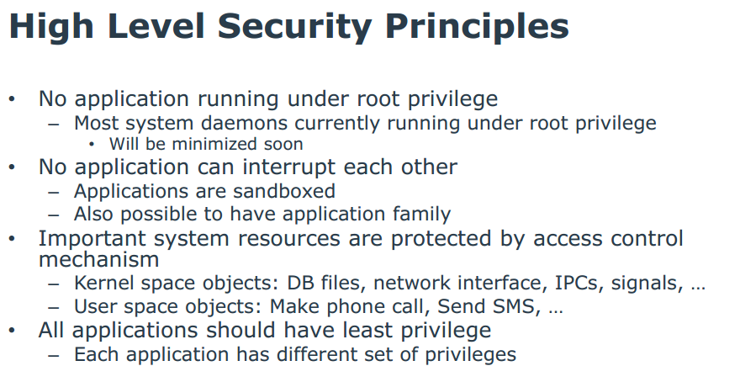
Tizen OS (Samsung) (to be seen in Chapter 8)

Slide 29
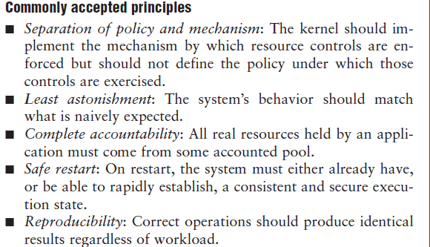
Principles used in the EROS OS J. Shapiro, IEEE Software, Jan/Feb 2002

Slide 30
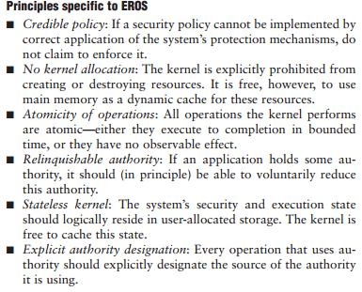

Slide 31
Kerkhoff’s principle (from the Wikipedia)
In cryptography, Kerckhoffs' principle (also called Kerckhoffs' desideratum, Kerckhoffs' assumption, axiom, doctrine or law) was stated by Dutch cryptographer Auguste Kerckhoffs in the 19th century: A cryptosystem should be secure even if everything about the system, except the key, is public knowledge.
Kerckhoffs' principle was reformulated (or perhaps independently formulated) by American mathematician Claude Shannon as "the enemy knows the system", i.e., "one ought to design systems under the assumption that the enemy will immediately gain full familiarity with them". In that form, it is called Shannon's maxim. In contrast to "security through obscurity", it is widely embraced by cryptographers.

Slide 32
Another principle
It is preferable to have a secure architecture with insecure code that secure code with an insecure architecture

Slide 33
Policies
Institution policies
Security policies
Example

Slide 34
Need for policies
The policies of an institution define its way of accomplishing its objectives
Security policies define its way to protect its information
Without policies we don’t know what we should protect
Policies are realized by security mechanisms (possibly described as patterns)

Slide 35
Institution policies I
Laws, rules, and practices that regulate how an institution manages and protects resources. Another definition is: high-level guidelines concerning information security. Computer mechanisms should enforce these policies.

Slide 36
Some security policies
Open/closed systems--In a closed system everything is forbidden unless explicitly allowed, forgetting a rule may bring annoyance but no security problems
Need-to-know (Least privilege)-- Give enough rights to perform duties, many attacks happened because users had too much access (increases temptation,…)
Authorization-- access types, small units of access, this is the granularity of access

Slide 37
Security policies II
Information belongs to the institution versus private ownership. Example: student information vs. my evaluations of students
Obligation—What has to be done before or after accessing data
Separation of duty—Separate critical functions into parts to be done by different people or systems. Requires collusion for illegal actions
Content-dependent access control—Access decision are based on the values of the data. I can see my own information but not others’.
Authenticate all transactions—needed for accountability and access control

Slide 38
Security policies III
Centralized/decentralized control-- In a decentralized system its units or divisions have their own administrators and authority to define their own policies or enforcement mechanisms as far as they don’t violate global policies.
Ownership and administration-- In many systems the user that creates some data becomes its owner and has all the rights on it. An administrative policy separates the administration of the data from its use. Ownership may violate separation of duty in that the user of information is also its administrator, which for institution data is a conflict of interest but it is acceptable for personal files.

Slide 39
Use of policies
Secure systems must be closed but sometimes open access to information is more important, e.g., libraries, data warehouses, …
The need-to-know principle must be applied with an appropriate granularity, many attacks happen because of too many rights

Slide 40
Example of university policies
An instructor can look at all the information about the course he is teaching.
An instructor can change the grades of the students in the course he is teaching
A student may look at her grades in a course she is taking
The department head can add/delete course offerings
The registrar can add/delete students from course offerings
Faculty members can look at information about themselves

Slide 41
Roles in policies
Originator—The person who issues a document
Authorizer—The person who controls access over the document
Custodian—The person who keeps the document and controls its use
User—The person who reads and/or modifies the document
Auditor—The person who checks the actions, results, and controls applied to documents.

Slide 42
Roles in Web services
Creator—this is a person or business that creates a web service and places it in a public repository. He wants only authorized customers to access his services.
Keeper of repositories of web services—these are the institutions that provide public catalogs of services. They must assure authorized access to these catalogs.
Provider or keeper of web services—these store the web services code and data. They may be the same as the keepers of repositories or the creators of web services, but could also be specialized institutions. As providers of web site functions they are concerned about proper access to their services and possible denial of service to their sites.
Consumer of web services—they expect good quality services without malicious software. If they send their data to a web service, this data should be used in the proper way and protected from leakage or corruption.

Slide 43
Other policies
Chinese Wall policy—Information is grouped into “conflict of interest “classes and a person is allowed access to at most one set of information in each class
Originator controlled (ORCON)—A document is released only to people or units in a list specified by the originator

Slide 44
Applying security policies to stop threats Example: a financial institution
Consider a financial company that provides investment services to its customers.
Customers can open and close accounts in person or through the Internet.
Customers who hold accounts can send orders to the company for buying or selling commodities (stocks, bonds, real estate, art, etc.).
Each customer account is in the charge of a custodian (a broker), who carries out the orders of the customers.
Customers send orders to their brokers by email or by phone.
A government auditor visits periodically to check for application of laws and regulations.
Figure 2.1 shows the Use Case diagram for this institution.

Slide 45
A financial institution

Slide 46
From threats to policies
A systematic way to identify system threats, and determining policies to stop and/or mitigate their effects
Analysis of the flow of events in a use case or a group of use cases, in which each activity is analyzed to uncover related threats. This analysis should be performed for all the system uses cases
Then we select appropriate security policies which can stop and/or mitigate the identified threats.

Slide 47
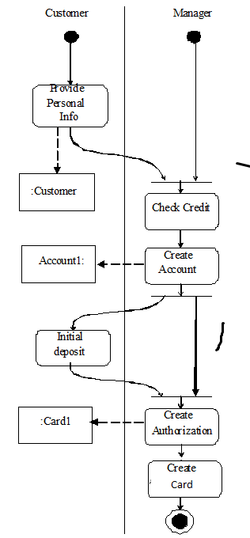

Slide 48
Threats for this use case
Use Cases 1 and 2: Customer is an impostor. Possible confidentiality and integrity violations.
Manager impersonation. Can capture customer information. Confidentiality attack.
Use Cases 3 and 4. Broker impersonation. Possible confidentiality violation.
Customer can deny giving a trade order. Repudiation. Customer impersonation. Confidentiality or integrity attacks.
Stockbroker embezzling customer’s money.
Use Case 5. Impersonation of auditor. Confidentiality violation.

Slide 50
Threats
T1.The customer is an impostor and opens an account in the name of another person
T2.The customer provides false information and opens an spurious account
T3.The manager is an impostor and collects data illegally
T4.The manager collects customer information to use illegally
T5.The manager creates a spurious account with the customer’s information
T6.The manager creates a spurious authorization card to access the account
T7.An attacker tries to prevent the customers to access their accounts
T8.An attacker tries to move money from an account to her own account

Slide 51
Use case analysis leads to policies
T1. T3. Mutual authentication. Every interaction across system nodes is authenticated.
T2. Verify source of information.
T4. Logging. Since the manager is using his legitimate rights we can only log his actions for auditing at a later time.
T5. T6. Separation of administration from use of data. For example, a manager can create accounts but should have no rights to withdraw or deposit in the account.
T7. Protection against denial of service. We need some redundancy in the system to increase its availability.
T8. Authorization. If the user is not explicitly authorized he should not be able to move money from any account.
Policies can be realized with patterns

Slide 52
Systematic mapping of threats to policies

Slide 53
Threat enumeration

Slide 54
Authorization and Logging
After a user is recognized as a legitimate user she is admitted to the system.
For the user to access specific resources (memory, files, I/O devices) or data items she needs authorization rights.
For every access (read or writes) to data a Logging system records the data item accessed, the time, the type of access, and the user who performed the access.
The log can be audited later to check the proper use of the data.

Slide 55
Threat/Misuse patterns
Describe threats and misuses from the point of view of the attacker.
We will use sequence diagrams (and more) to describe how an attacker performs a misuse, they describe attack scenarios
The pattern tries to show how the attacker works (modus operandi) so we can apply defenses to stop it
The objects in the sequence diagram represent architectural units of the target system

Slide 56
Security models
Classification
Access matrix
Role-Based Access Control
Multilevel security

Slide 57
Models
Security models are a more precise and detailed expression of policies and are used as guidelines to build and evaluate systems. Usually they are described in formal or semi-formal way.
Models can be discretionary or mandatory. In a discretionary model, holders of rights can be allowed to transfer them at their discretion. In a mandatory model only designated roles are allowed to grant rights and users cannot transfer them
An orthogonal classification divides models into those based on the access matrix, Role-Based Access Control, and multilevel models. The first two of these models control access while the last one attempts to control information flow. Mandatory and discretionary models can be combined with the access matrix and the multilevel model.

Slide 58
Classification of authorization models
Multilevel --users and data are assigned security levels
Access matrix -- subject has specific type of access to data objects
Mandatory --access rules defined only by administrators
Discretionary -- users own data and can grant access to other users

Slide 60
Account
Customer
TX
Authentication
Authentication
Authorization
Logging

Slide 61
Access matrix authorization rules
Basic rule ( s, o, t ) , where s is a subject (active entity), t is an access type, and o is an object
Extended rule ( s, o , t , p,f) , where p is a predicate (access condition or guard) and f is a copy flag
This, and the other models, can be described by OO patterns

Slide 62
Administrative rights
transfer{t/t*} to M(s,o)---transfer can be destructive or not, depending on the policy.
grant{t/t*} to M(s,o)—in a grant both grantor and grantee have the right after the grant.
delete t from M(s,o)—a right is removed from a subject.
read M(s,o)—inspect the right of a subject for an object.
create object o
delete object o
create subject s
delete subject s

Slide 63
Authorization pattern

Slide 64
Authorization mapping

Slide 65
Reference Monitor
Each request for resources must be intercepted and evaluated for authorized access
Abstract concept, implemented as memory access manager, file permission checks, CORBA adapters, etc.

Slide 66
Reference Monitor idea

Slide 67
Reference monitor pattern (basic idea)

Slide 68
Reference monitor (complete)

Slide 69
Enforcing access control

Slide 70
Role-Based Access Control
Users are assigned roles according to their functions and given the needed rights (access types for specific objects)
When users are assigned by administrators, this is a mandatory model
Can implement least privilege and separation of duty policies
Reduces number of rules

Slide 71
Basic RBAC pattern

Slide 72
Growing models
We can grow models by adding classes, e.g. from Authorization to RBAC we add a Role class.
We can add sessions as execution context
We can add hierarchies of roles and of objects (Composite pattern)
Subroles inherit role rights from superclass roles.
Access to an object gives implicit access to its subobjects

Slide 74
More extensions to RBAC
Separation of administrative roles: administrators have special rights to create users, roles, grant rights,…
Groups of users: a set of users taken as a whole for access rights
8/28/2017
74

Slide 75
Extended RBAC pattern

Slide 76
Role rights for financial institution
Customers can open/close accounts
Customers can initiate trade
Broker can perform trade
Auditor can inspect (read) trade transactions
8/28/2017
76

Slide 77
8/28/2017
77

Slide 78
Implied authorization
For convenience we may need to group or structure subjects, protection objects, and some access types in such a way that they may imply others in some ordering structure. In this case, a rule component may be implied by another rule and this must be taken into account when evaluating access.
The concept of implied authorization was introduced in [Fer75b] and subsequently has been applied in some research projects and used in the later versions of the Windows operating system (starting with NT Version 4.0) and the .NET component authorization. It has also been applied to object-oriented databases where access rights can be inherited along generalization or aggregation hierarchies as we discuss in the chapter on database systems.

Slide 79
Nearly Every U.S. Arms Program Found Vulnerable to Cyber Attacks http://www.nytimes.com/reuters/2015/01/20/technology/20reuters-cybersecurity-pentagon.html?_r=0
WASHINGTON — Nearly every U.S. weapons program tested in fiscal 2014 showed "significant vulnerabilities" to cyber attacks, including misconfigured, unpatched and outdated software, the Pentagon's chief weapons tester said in his annual report released Tuesday.
Michael Gilmore, director of operational test and evaluation (DOT&E), said program managers had worked to resolve problems discovered in previous years and security was improving, but this year's testing had revealed new vulnerabilities.
The report comes amid growing attention to cybersecurity within the U.S. government, and was released days after fresh documents leaked by former U.S. intelligence contractor Edward Snowden said China had stolen "many terabytes" of data about the Lockheed Martin Corp F-35 fighter jet.

Slide 80

Assignment 2
Q1 (Chapter 2): Consider a use case to borrow a book in a library. It has the following actions: A1: the customer presents a book she wants to borrow to be scanned; A2: the customer presents her card to have the book charged to it; A3: the catalog of available books is updated.
a) Enumerate the possible threats
b) Indicate policies to stop these threats

Slide 81
Q1 solution
We assume that Attacker can only apply the same operation on assets as the activity (action)
A1 (action 1)- T11 (threat 1 of Action 1)—Asset: Book--Attacker can change the book id information after it has been scanned (we cannot control physical attacks to books by using software) and replace it with the one of a cheaper book (the system would not allow to charge no book) so he could make some money (an integrity attack)
A2-T21—Asset: Customer Card--Attacker can have the book charged to another customer to obtain a free book (integrity attack)
A3- T31—Asset: Catalog-Attacker can change information about availability of books for disruption purposes (DoS attack)

Slide 82
Q1 Sol. (Cont.)
b) Policies for defenses
For each threat we should consider if it is performed by an external attacker or an insider
Defenses must be correlated with the specific threats
Threats must be correlated with activities; we need to be systematic to make sure we found all the threats
T11-T31: External—P1 (Authentication and Authorization)
Insider—P2 (Logging and Auditing)
A&A cannot stop insiders since they have the right to change IDs
for example, but we can find out later what they did

Slide 83
Multilevel models
Because of the way they control security they have also been called data (information) flow models, they control the allowed flow of data between hierarchical levels. These models have been formalized in three different ways:
The Bell-La Padula model, intended to control leakage of information between levels.
The Biba model, which controls data integrity.
The Lattice model, which generalizes the partially ordered levels of the previous models using the concept of mathematical lattices.

Slide 84
Features of the multilevel models
Users and data are assigned classifications or clearances
They are mandatory models (users are assigned to classifications by administrators)
Classifications include levels (top secret, secret,…), and categories (compartments) (engDept, marketingDept, Army, …)
Typically use data labels (tags) to indicate their classifications or levels, used to enforce security
In each level an access matrix may further refine access control.
Need trusted processes to perform administrative functions (e.g., declassify documents, increase a user’s clearance) so secure flow of control is not violated

Slide 85
Categories and levels
Army
Navy
Air Force
Top Secret
Secret
Levels
Confidential
Classified

Slide 86
Bell-LaPadula rules (confidentiality)
Simple security (ss) property. A subject s may read object o only if its classification dominates the object’s classification, i.e., C(s) => C(o). This is the no read-up property.
*-Property. A subject s that can read object o is allowed to write object p only if the classification of p dominates the classification of o, i.e., C(p) => C(o). This is the no write-down property.
A security classification dominates another if and only if its level is greater or equal than the other level and its categories include the other categories. For example, in the next figure, level L1 dominates level L2. Security levels L1 and L3 or L2 and L3 are incomparable.

Slide 88
Example of Bell and LaPadula Model
O₅
high
(w)
(w)
S₂
O₄
(r)
(r)
O₃
(w)
(w)
S₁
O₂
(r)
(r)
low
O
S
O₁

Slide 89
The Biba integrity model
Biba’s model classifies the data into integrity levels and defines two properties dual to the simple security and * properties. This model includes the properties:
Single integrity property. Subject s can modify object o only if I(s) >= I(o).
Integrity *-property. If subject s has read access to object o with integrity level I(o), s can write object p only if I(o) >= I(p).
The first property establishes that an untrusted subject cannot write in objects of a higher level of integrity or she would degrade that object.
The * property protects information from flowing up the hierarchy

Slide 90
Biba Model (2)
BLP
BIBA
O₅
high
(w)
(r)
(w)
S₂
O₄
(r)
(r)
(w)
(w)
O₃
(w)
(r)
(r)
(w)
(w)
S₁
O₂
(r)
(r)
(w)
(w)
O₁
low
(r)

Slide 91
Multilevel security pattern (BellLaPadula)

Slide 92
Governance

Slide 93
Magic Quadrant for Security Information and Event Management Published: 10 August 2016 ID: G00290113 Analyst(s): Kelly M. Kavanagh, Oliver Rochford, Toby Bussa
http://learn.alienvault.com/c/gartner-reprint-2?x=M6R9kL&xs=348&utm_internal=siemlookbook

Slide 94
Gartner Magic Quadrant
The security information and event management (SIEM) market is defined by the customer's need to analyze event data in real time for the early detection of targeted attacks and data breaches, and to collect, store, investigate and report on log data for incident response, forensics and regulatory compliance. The vendors included in our Magic Quadrant analysis have products designed for this purpose, and they actively market and sell these technologies to the security buying center.
SIEM technology aggregates event data produced by security devices, network infrastructure, systems and applications. The primary data source is log data, but SIEM technology can also process other forms of data, such as NetFlow and network packets. Event data is combined with contextual information about users, assets, threats and vulnerabilities. The data is normalized, so that events, data and contextual information from disparate sources can be correlated and analyzed for specific purposes, such as network security event monitoring, user activity monitoring and compliance reporting. The technology provides real-time correlation of events for security monitoring, query and analytics for historical analysis and other support for incident investigation and compliance reporting.

Slide 95
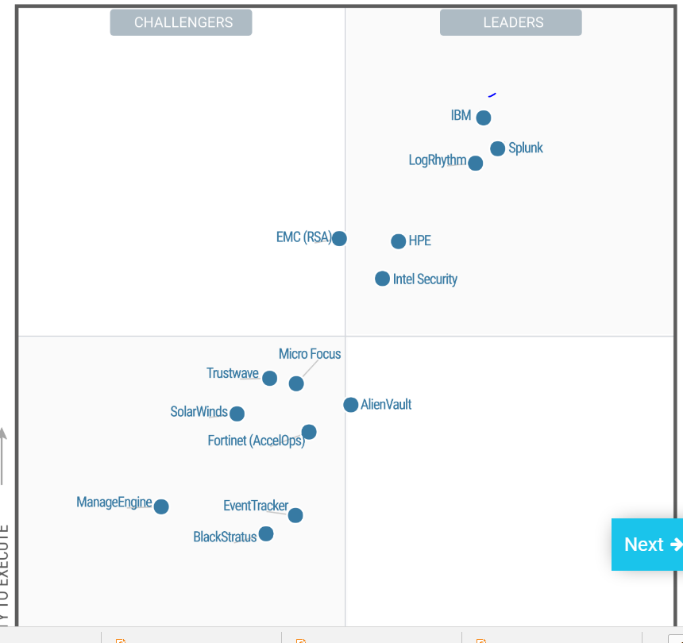

Slide 96
More examples
The following three slides describe the solutions to examples from past years.

Slide 97
A branch of computer security tries to prevent attacks by analyzing code in order to detect vulnerabilities. Analyze critically this approach. Consider its good and bad points
Good points:
It is possible to check every line of code using tools and detect many vulnerabilities, which can be corrected before releasing the software
Only possible approach for systems built without models
Disadvantages: Long and expensive job, many lines of code
Cannot catch attacks due to system unit interactions
Code changes a lot and every time you need to repeat the checks
If the only method used, it is a brute force approach
The code analysis is usually static which might not be appropriate for dynamic languages such as PHP or Ruby .
A hybrid (models +code checking) method could be effective (research project)

Slide 98
Databases are becoming more and more linked, e.g. medical, law, driving, real estate information, are getting all connected. This means that it is rather easy to get all kinds of information about individuals. One individual said: "I don't mind, I have nothing to hide". What is wrong with this position?
Argument 1: Innocent information can be intentionally used out of context to defame somebody
Argument 2: There can be misinterpretation of information even with good intention
Argument 3: How do you know that the databases have only correct information about you?
Argument 4: More opportunity for identity theft if the database is compromised

Slide 99
Q1: Consider the Bagle worm, and study if it could have been avoided by having mechanisms that implemented appropriate policies. Indicate these policies and discuss how they could prevent the attack.
The Bagle malware works as: if a user opens its executable attachment it copies itself in the system directory.
Then it runs a program to download another part of it from a specific address in the web.
Finally, it scans the hard drive searching for email addresses. With each address it finds it sends itself using its own SMTP (Simple Mail Transfer Protocol) engine (a mail server).
We need to analyze its activities (signature) :
Input through attachments or ports—User training, security audit of ports could prevent the worm entering the system
Copies itself to the system directory as an executable file– Apply authorization to read/write system directory so the worm cannot attach itself
Installs and runs a program to download another part of itself from the web—control of access to Internet addresses (firewall) would prevent downloading other parts
Reads some files to harvest email addresses—Apply authorization for access to files so the worm cannot read them
Opens a backdoor on a TCP port—Authorization to access ports can prevent the worm from finding a way out
Emails itself using its own SMTP engine—Traffic monitoring (IDS) would detect unusual activity

Slide 100
Q2 Assignment 2
Find threats for the activities of Use Case “Delete course section”:
A1: Find courses with enrollment under 5 students
A2: Delete their enrolled students
A3: Delete the courses from the semester catalog
T11: Increase number of students and keep a course that should have been deleted
Reading is not considered a problem
T12: select courses with more than 5 students to be deleted
T21: read list of students (confidentiality attack)
T22: delete students from a course that should have been kept (result of T12)
T31: delete course which should have not been deleted (result of T12)

Slide 101
Q3 Assig 2
Security in Knox (https://www.samsungknox.com/en):
separation of business and personal contexts (two virtual
machines)
two-factor biometric authentication
SSO (KNOX IAM)
cloud-based administrative portal (BYOD)
integrated VPN (Cisco, F5, Juniper)
whitelist and blacklist access control
communications and device encryption

Slide 102
Q3 Cont.
iPhone security http://www.apple.com/business/docs/iOS_Security_Guide.pdf
Encryption
File protection
App security
SSL/TLS
SSO
IPSec and SSL VPNs
WPA2 Enterprise (WiFi security)

Slide 103
An example of selection of security mechanisms
Consider a company that keeps information about individuals to be used for credit checking, employment suitability, or similar. This information will be kept in a distributed relational database system running in several clusters of processors. Customers ask for reports about individuals using the Internet. The reports show all or some of the information about an individual kept by the company. Customers can also ask for queries such as “all the individuals who have a high credit rating” or similar. Our employee interfaces are in different parts of the company, maybe in different cities. Indicate which network protection is needed in our system to let employees perform securely these functions.
UC1: Message authentication, Proxy firewall
UC2: Message aurhentiocation, IP VPN
UC3: Message authentication, IP VPN
UC4: Message authentication, IP VPN
UC5 : Message authentication, Proxy firewall, SSL VPN
UC6: Message authentication, Proxy firewall, SSL VPN

Slide 104
UCs
1, Create record for person Data Reception create, modify, read (query) records
2. Modify person record Data maintenance read (query), modify records
3. Delete person record Record maintenance query, delete records
4. Authorize access to records Security Admin assign users to roles,
assign rights to roles
5. Audit use of records Auditor query records
6. Request person record Person (customer) read/copy record (own record)

Slide 105
Assignment submission
Email only one file of type doc, docx, ppt, pptx, or pdf to ed@cse.fau.edu Call your file EFCNT4403Assign_X (replace EF by your own initials, X is 1 now). Put your name, course, and assignment number in the paper I will acknowledge reception within two days; if not, resend your paper.
Your answers should be precise and concise. Separate concerns in different paragraphs (itemized list), do not write one long paragraph. Do not include unnecessary descriptions, just answer the questions. Research question answers should be backed by references.

Slide 106
References
Olga Gadyatskaya; Fabio Massacci; Yury Zhauniarovich, “Security in the Firefox OS and Tizen Mobile Platforms”, Computer , 2014, Volume: 47, Issue: 6 , 57 - 63, DOI: 10.1109/MC.2014.165

